Slide 1

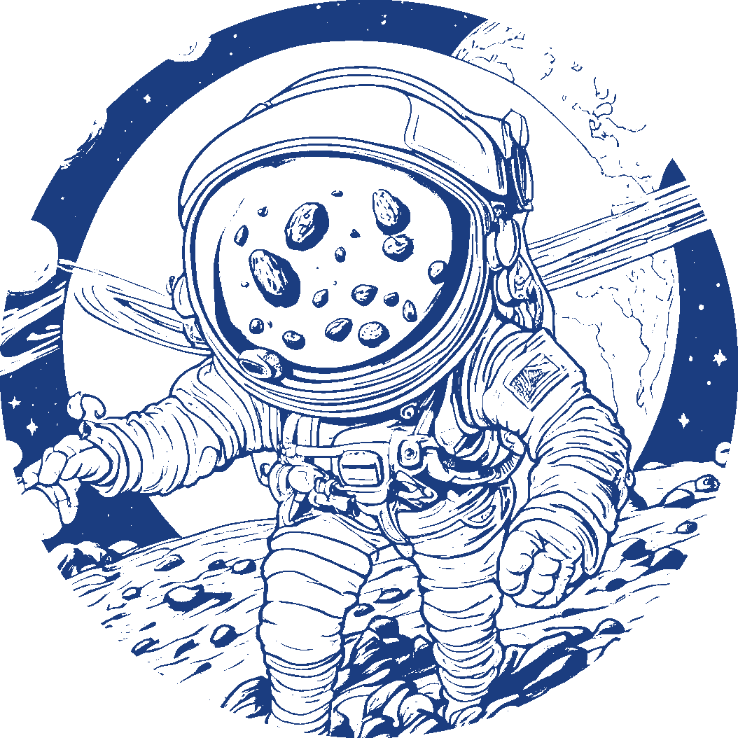
Seismic Detection Across the Solar System
Team members:
Veljko Durkovic
Predrag Budrak
Nikola Lukic
Team name: AstroNutzz
From: Montenegro

Slide 2
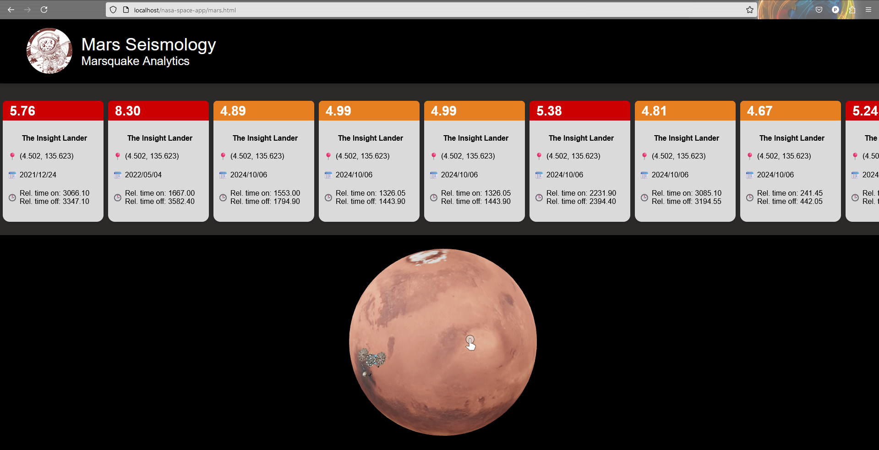
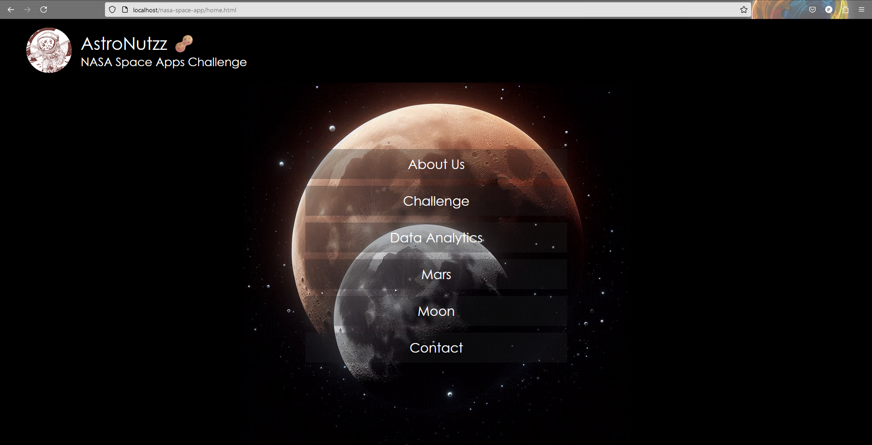
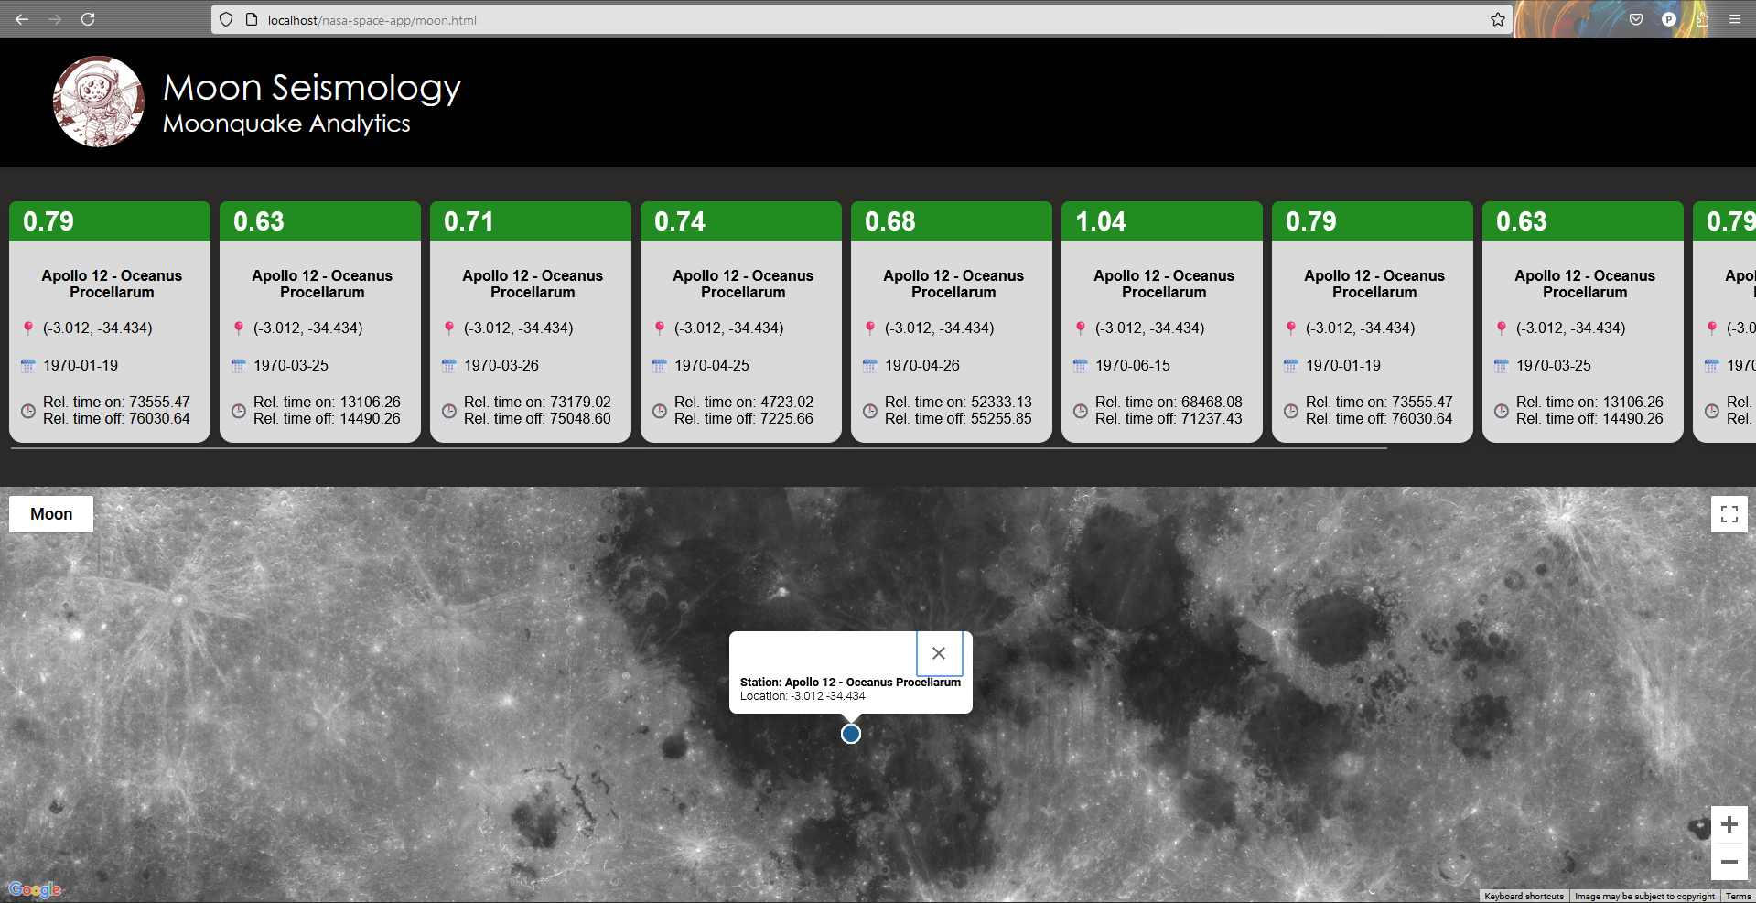
Only a fraction of seismic data that’s sent back to Earth is scientifically useful!
That’s when our algorithm comes to the scene!
Using data provided by NASA, we made an app that can successfully distinguish seismic events from noise and other sound recorded by NASA missions on the Moon and Mars.
And not only that – all data is after processing sent to our database and shown on our website! Take a look and enjoy:
You can even see locations of NASA landers!

Slide 3
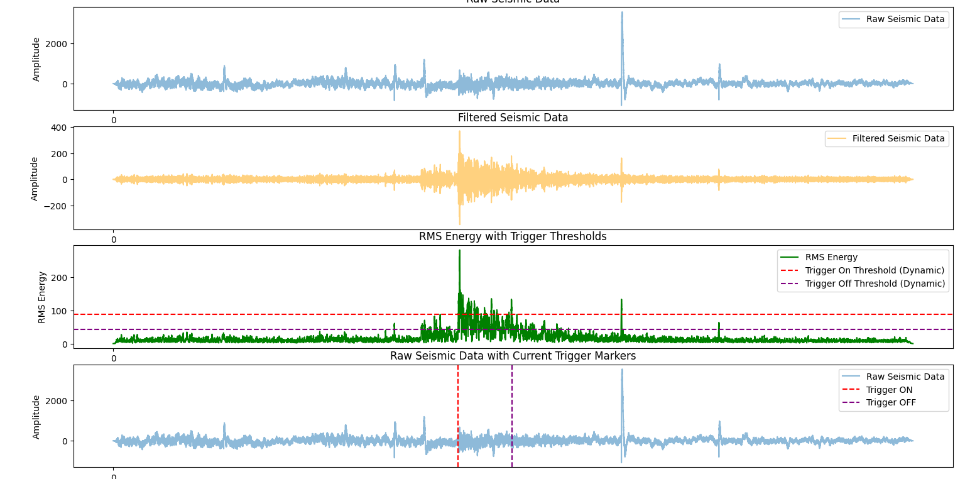
What does our code actually work?
Plot 1:
Raw seismic data from Mars. It’s very difficult to see earthquake!
Let’s see on data sample from Mars!
Plot 2:
Data is filtered and prepared for analysis!
Plot 3:
Using dynamic thresholds, energy of the signal is analyzed in order to find moonquake start time and end time!
Now we can calculate magnitude and send all necessary data to the Earth.

Slide 4
Where can you find the code?
Our GitHub repository:
If you want to use the code, please read “README.txt” file first and also “For Global Judges.txt”
There you will find all necessary instructions for using the code properly.
https://github.com/veljkoDjurkovic/Space_Quakes_Data_Analytics
There we have:
All test data provided by NASA analyzed and plotted
Catalogs in CSV form
All HTML, CSS and Python files for website and also our main code which finds start time, end time and magnitude!

Slide 5
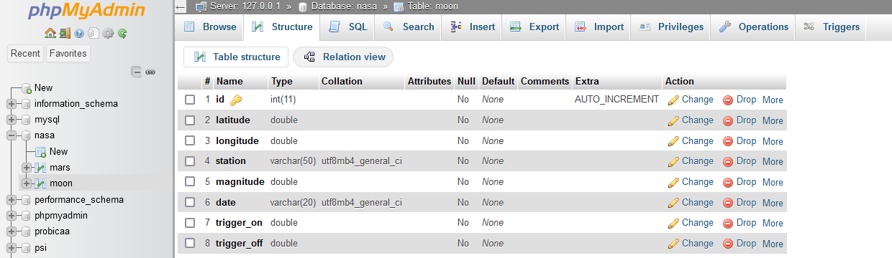
Our Database
Data is being collected and sent to our database and after that published to website.
SQL table contains information about location of a station, its name, date when seismological activity was registered, magnitude and also trigger_on and trigger_off which represent relative time of start and end of the activity.

Slide 6
Advantages of our code
Sending data to the Earth takes a lot of resources and spends a lot of energy! In order to be efficient in terms of saving energy and memory we chose selectivity as one of our main principles! Only important segments of recorded data are sent to the Earth.
There’s not as much data from Mars and Moon as we have for Earth. That’s why training AI models can be very tricky and non efficient. Our algorithm is very effective even with small amount of data.

Slide 7
SUMMARY:
“Knowledge is the golden ladder over which we climb to heaven.
Knowledge is the light which illuminates our path through this life
and leads to a future life of everlasting glory.”
M. Pupin (Serbian-American scientist, founding member of NASA)
Distinguishing actual seismic activity from noise using signal analysis based on frequency and energy with help of dynamic thresholds
Sending only necessary part of data to database
Showing results on the website with graphical presentation of both Moon and Mars. Showing real locations of the NASA stations with data about moon (mars)quakes.

